Slide 1
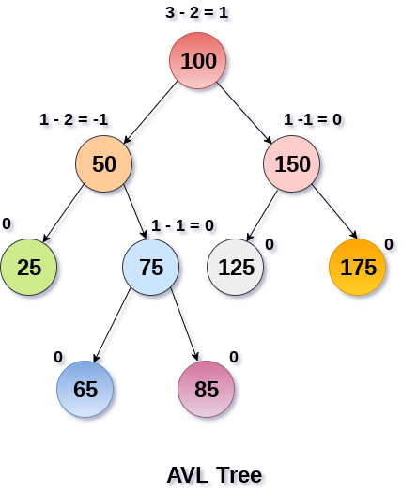
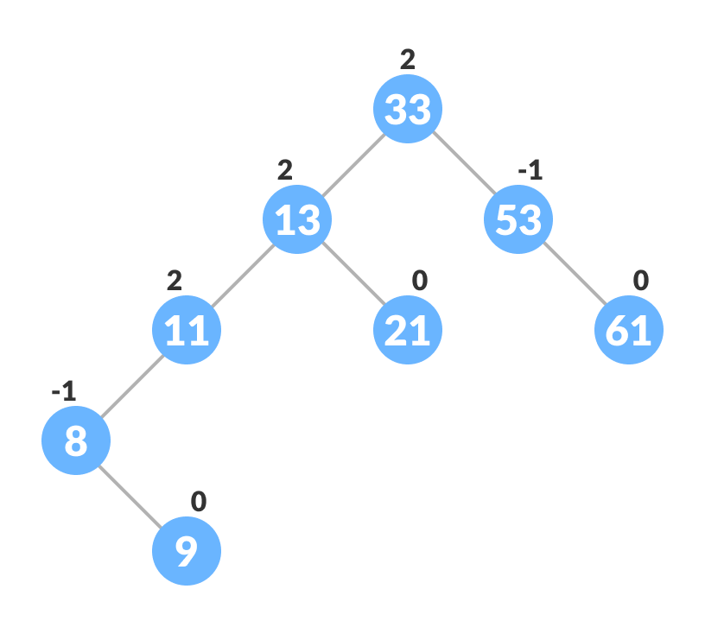
AVL Tree
AVL tree is a self balancing binary search tree
Adelson, Velsky and Landis were its inventor
It is also called height balanced tree
It is expected that each node of balance AVL tree should have
value of balance factor either of (1, 0, -1)
➔If any node of tree violates balance factor of tree then
➔Balance Factor = Height of left sub tree - Height of right sub tree

Slide 2
How to balance an AVL Tree
By using AVL- Rotation
Four types
LL-Rotation
RR-Rotation
LR-Rotation
RL-Rotation

Slide 3
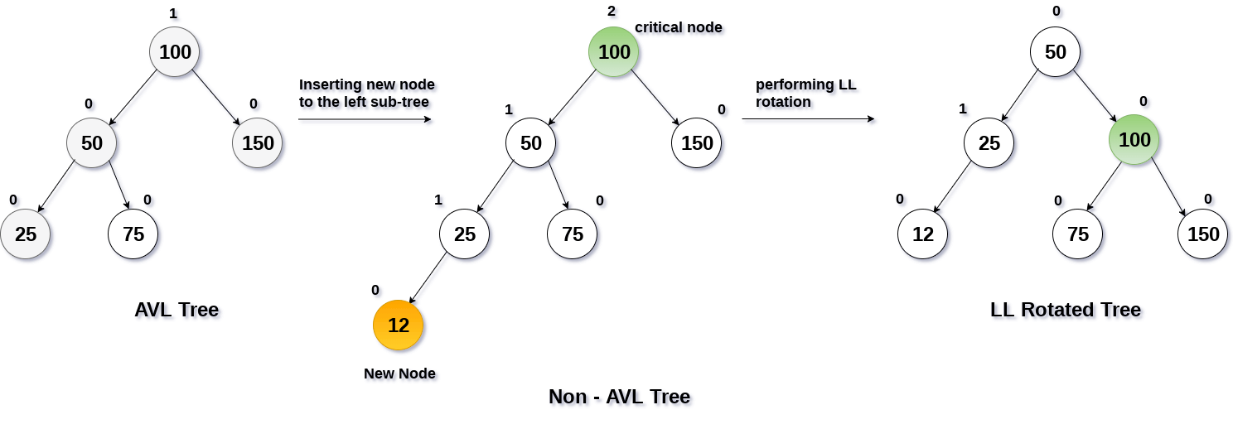
LL-Rotation
If we insert any node on left side of left subtree of root node and tree get unbalanced then
LL-Rotation will require to make it balance

Slide 4
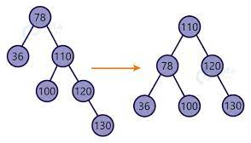
RR-Rotation
If we insert any node on right side of right subtree of root node and tree get unbalanced then
RR-Rotation will require to make it balance

Slide 5
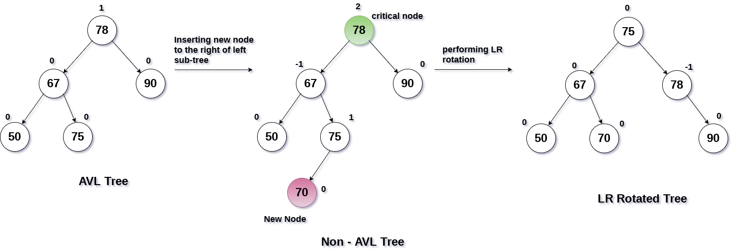
LR-Rotation
If we insert any node on right side of left subtree of root node and tree get unbalanced then
LR-Rotation will require to make it balance. It require two rotation first on inserted node and
Second on root node.

Slide 6
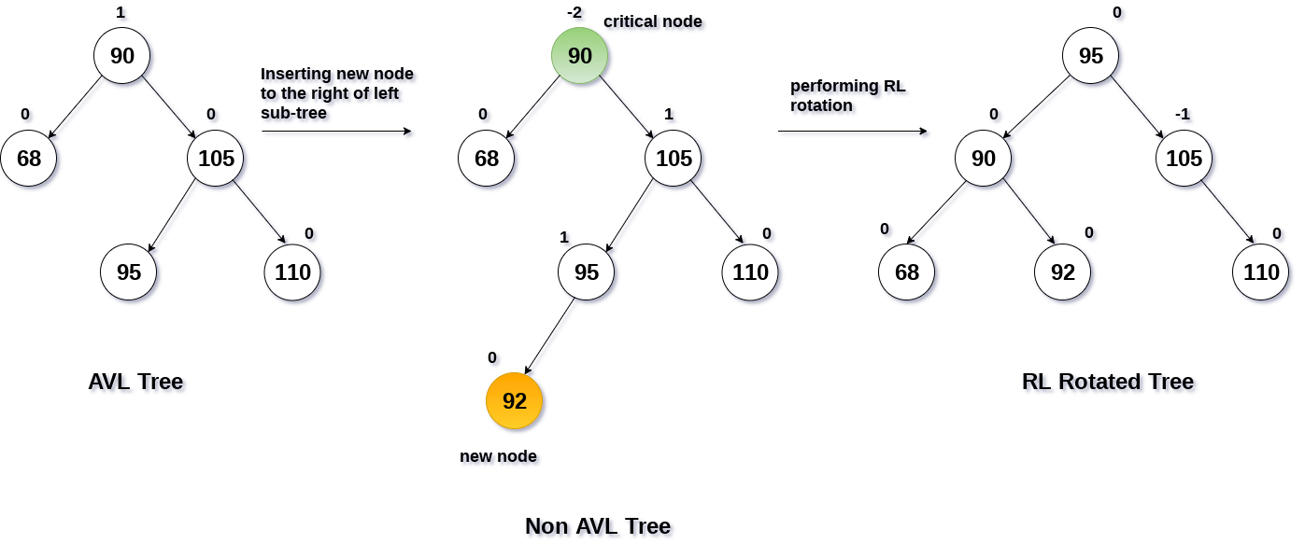
RL-Rotation
If we insert any node on left side of right subtree of root node and tree get unbalanced then
RL-Rotation will require to make it balance. It require two rotation first on inserted node and
Second on root node.

Slide 7
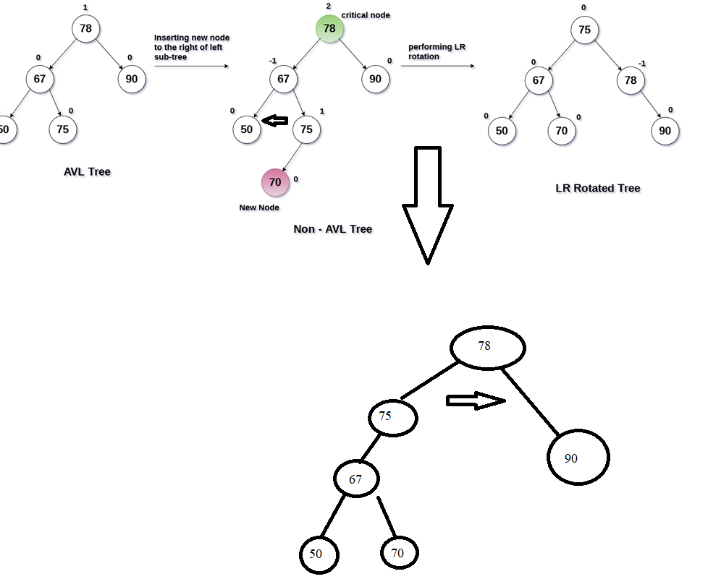
LR-Rotation

Slide 8
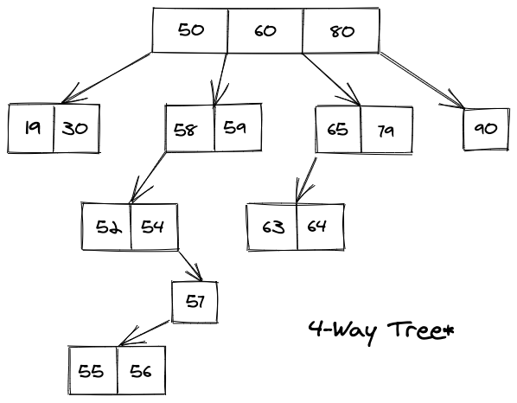
Multi-way Tree
It is also known as M-way tree.
M-way(multi-way) tree is a tree that has the following properties:
Each node in the tree can have at most m children.
Nodes in the tree have at most (m-1) key fields and references to the children.

Slide 9
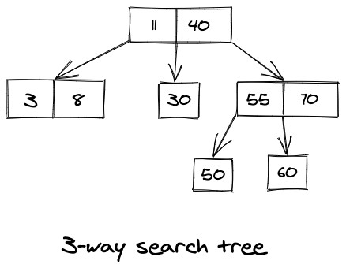
M-way Search Trees
The constraints on an M-way tree that makes it an M-way search tree are:
Each node in the tree can associate with m children and m-1 key fields.
The keys in any node of the tree are arranged in a sorted order(ascending).
The keys in the first K children are less than the Kth key of this node.
The keys in the last (m-K) children are higher than the Kth key.

Slide 10
Searching in an M-way Search Tree
If we want to search for a value say X in an M-way search tree and currently we are at a node
that contains key values from Y1, Y2, Y3,.....,Yk. Then in total 4 cases are possible to deal with
this scenario, these are:
If X < Y1, then we need to recursively traverse the left subtree of Y1.
If X > Yk, then we need to recursively traverse the right subtree of Yk.
If X = Yi, for some i, then we are done, and can return.
Last and only remaining case is that when for some i we have Yi < X < Y(i+1), then in this
case we need to recursively traverse the subtree that is present in between Yi and Y(i+1).

Slide 11
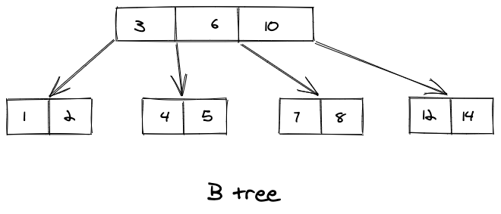
B Trees
A B tree is an extension of an M-way search tree. Besides having all the properties of an M-way
search tree, it has some properties of its own, these mainly are:
All the leaf nodes in a B tree are at the same level.
All internal nodes must have M/2 children.
If the root node is a non leaf node, then it must have at least two children.
All nodes except the root node, must have at least [M/2]-1 keys and at most M-1 keys.

Slide 12
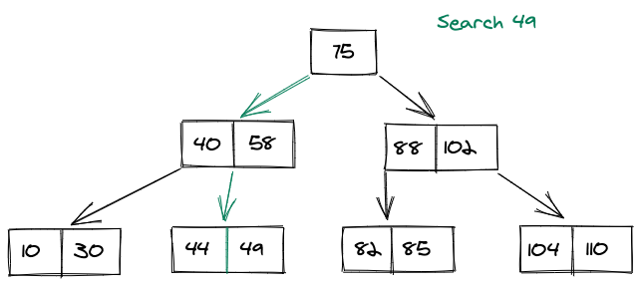
Searching in a B Tree
Say if we want to search for a key 49 in the below shown B tree. We do it as following
Compare item 49 with root node 75. Since 49 < 75 hence, move to its left sub-tree.
Since, 40<49<58, traverse right sub-tree of 40.
49>44, move to right. Compare 49.
We have found 49, hence returning.

Slide 13
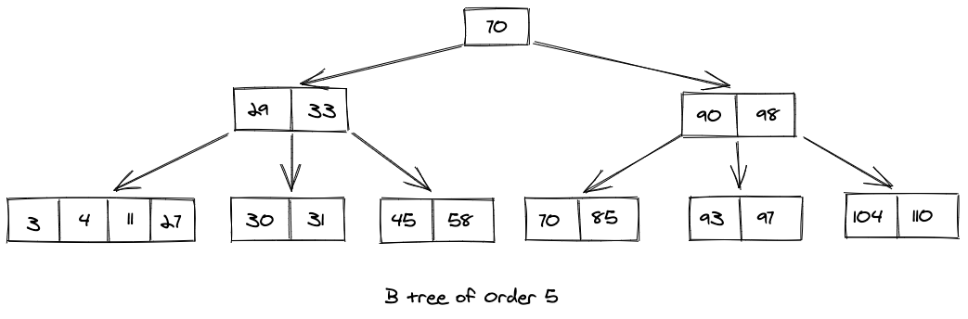
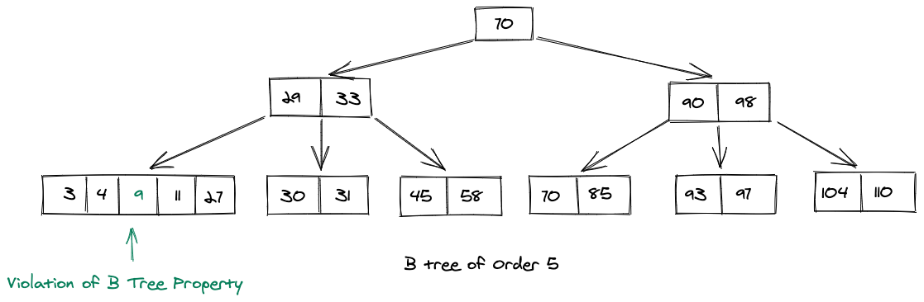
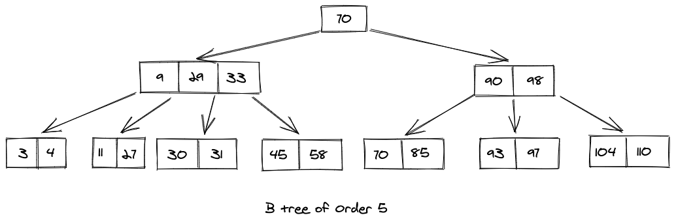
Inserting in a B Tree
Inserting in a B tree is done at the leaf node level.
consider that we want to insert a key 9
Since, a violation occurred, we need to push
the median node to the parent node, and
then split the node in two parts

Slide 14
Key Points of B Tree
The time complexity for search, insert and delete operations in a B tree is O(log n).
The minimum number of keys in a B tree should be [M/2] - 1.
The maximum number of keys in a B tree should be M-1.
All the leaf nodes in a B tree should be at the same level.
All the keys in a node in a binary tree are in increasing order.
B Trees are used in SQL to improve the efficiency of queries.
Each node in a B Tree can have at most M children.

